Slide 1
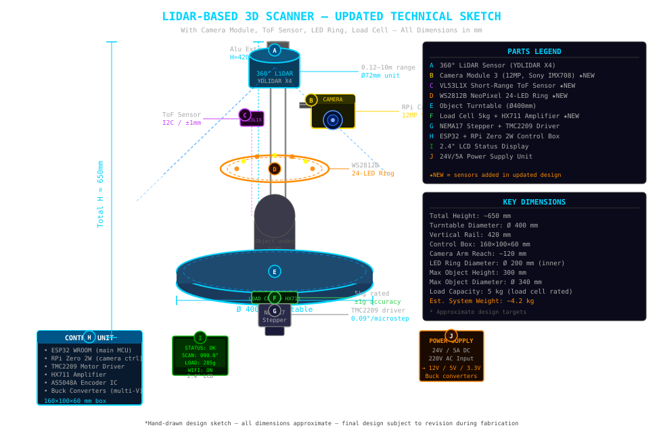
04 — IMPLEMENTATION | Updated Technical Sketch (With New Sensors)
Slide 7 (Updated)
★ New sensors: RPi Camera Module 3 (B) | VL53L1X ToF (C) | WS2812B LED Ring (D) | Load Cell + HX711 (F)

Slide 2
05 — COMPONENTS USED & TECHNOLOGIES (Updated)
Slide 8 (Updated)
⚙ HARDWARE COMPONENTS
💻 SOFTWARE & TECHNOLOGIES
Sensor / Component | Spec
YDLIDAR X4 (LiDAR) | 0.12–10m, 0.5° res., UART, ~$100
★ RPi Camera Module 3 | 12MP Sony IMX708, autofocus, CSI
★ RPi Zero 2W (cam ctrl) | Quad-core 1GHz, 512MB, Wi-Fi
★ VL53L1X ToF Sensor | ±1mm, 4m range, I2C, ~$5
★ WS2812B NeoPixel Ring (24) | 5V, SPI/PWM, programmable RGB
★ Load Cell 5kg + HX711 | ±1g accuracy, 24-bit ADC, SPI
ESP32 WROOM MCU | 240MHz, Wi-Fi/BLE, FreeRTOS
NEMA17 Stepper Motor | 1.8°/step, 0.5Nm, 12V
TMC2209 Motor Driver | microstepping, silent, UART
AS5048A Magnetic Encoder | 14-bit, SPI, absolute angle
MPU-6050 IMU | 6-DOF, I2C, vibration detect
2.4" ILI9341 LCD | SPI, 320×240, status display
SD Card Module (32GB) | FAT32, SPI, scan data buffer
24V 5A DC Power Supply | 220V AC input, 120W, multi-rail
Aluminum Extrusion 2020 | 420mm rails, T-nuts, brackets
Custom PCB + 608ZZ Bearings | PCB ~$30, bearings ×4 ~$10
Layer | Tools / Stack
Firmware (ESP32) | Arduino IDE, FreeRTOS C/C++
Camera Control | ★ Python + PiCamera2 (RPi Zero)
LiDAR Driver | YDLIDAR SDK (C++ / Python)
Motor Control | Custom stepper lib + TMC2209 UART
Point Cloud | PCL (C++) + Open3D (Python)
★ Texture Mapping | OpenCV, UV projection, Blender CLI
★ Object Detection | VL53L1X lib, auto-height config
★ Weight Logging | HX711 lib, metadata JSON logging
★ LED Control | NeoPixel lib (ESP32 RMT driver)
Processing Pipeline | Python + NumPy + SciPy
Backend API | Flask (Python), REST, CORS
Cloud Storage | AWS S3 / Firebase (HTTPS)
Web Frontend | React.js + Three.js + WebSocket
3D Model Export | PLY (colour) / OBJ / STL
Database | Firebase Firestore (scan metadata)
Version Control | Git + GitHub (team collaboration)
★ Yellow = newly added components/software for Camera, ToF, LED Ring & Load Cell subsystems

Slide 3
06 — EXPECTED BUDGET (LKR) — Updated
Slide 9 (Updated)
Exchange rate: 1 USD ≈ LKR 305 | ★ = newly added items
Component / Item | USD | LKR
YDLIDAR X4 LiDAR Sensor | $100 | 30,500
★ RPi Camera Module 3 (Sony IMX708) | $25 | 7,625
★ Raspberry Pi Zero 2W | $15 | 4,575
★ VL53L1X Short-Range ToF Sensor | $5 | 1,525
★ WS2812B NeoPixel LED Ring (24px) | $8 | 2,440
★ Load Cell 5kg | $3 | 915
★ HX711 Amplifier Module | $2 | 610
ESP32 WROOM Dev Board | $5 | 1,525
NEMA17 Stepper Motor (×2) | $30 | 9,150
TMC2209 Motor Driver (×2) | $15 | 4,575
AS5048A Magnetic Encoder | $12 | 3,660
MPU-6050 IMU Module | $3 | 915
2.4" ILI9341 LCD Display | $5 | 1,525
Aluminum Extrusion 2020 (4×500mm) | $20 | 6,100
Ball Bearings 608ZZ (×4) | $5 | 1,525
Object Turntable Platform (custom) | $25 | 7,625
Custom PCB + Prototype Board | $30 | 9,150
SD Card Module + 32GB Card | $8 | 2,440
24V 5A Power Supply | $18 | 5,490
★ Camera Arm Mount (3D printed) | $5 | 1,525
Wiring, Connectors, Misc. | $25 | 7,625
3D Printed Parts / Enclosure | $25 | 7,625
Fasteners, Hardware | $10 | 3,050
Cloud: AWS S3 / Firebase | $0 | 0
PREVIOUS TOTAL (without new sensors) | ~$331 | 96,960
★ ADDITIONAL COST (new sensors) | +$63 | +24,735
UPDATED TOTAL ESTIMATED COST | ~$394 | 1,19,695
* Prices are estimates. RPi Camera Module 3 may require import — check local availability. AWS/Firebase free tier covers ~5GB storage.

Slide 4
07 — WORK DISTRIBUTION (Updated — Equal HW + SW per member)
Slide 10 (Updated)
M1
LiDAR & Point Cloud
M2
Camera & Texture Mapping
M3
Embedded Systems & Motor
M4
Sensing & Cloud Backend
M5
Display, LED & Web Frontend
⚙ HARDWARE
⚙ HARDWARE
⚙ HARDWARE
⚙ HARDWARE
⚙ HARDWARE
• YDLIDAR X4 UART driver integration
★ RPi Camera Module 3 setup
• NEMA17 + TMC2209 wiring & config
★ Load Cell + HX711 calibration
★ WS2812B LED ring mount + wiring
• Sensor mount & calibration jig
★ RPi Zero 2W wiring + CSI config
• AS5048A encoder integration
★ VL53L1X ToF wiring + I2C test
• 2.4" LCD SPI wiring + enclosure
• LiDAR angle-sync with encoder
• Camera arm mechanical mounting
• Ball bearing assembly + alignment
• Power rail design (24V/12V/5V/3.3V)
• Power management & fuse design
• Accuracy validation with known objects
• Turntable sync trigger hardware
• Custom PCB schematic & layout
• PCB fabrication & assembly
• Full system wiring & cable management
💻 SOFTWARE
💻 SOFTWARE
💻 SOFTWARE
💻 SOFTWARE
💻 SOFTWARE
• PCL / Open3D pipeline development
★ PiCamera2 capture software
• FreeRTOS task architecture (ESP32)
★ Auto-height detection logic
★ NeoPixel LED control (RMT driver)
• Statistical outlier removal + filtering
★ UV texture projection (OpenCV)
• Stepper pulse + microstepping code
★ Weight logging + scan metadata
• LCD status display firmware
• Poisson surface reconstruction
• Color PLY / textured OBJ generation
• Inter-task synchronization logic
• Flask REST API development
• React web dashboard + WebSocket
• PLY / OBJ / STL export pipeline
• Camera–LiDAR registration algorithm
• UART / SPI / I2C driver layer
• AWS S3 / Firebase upload pipeline
• Three.js 3D model viewer + download
★ Yellow = tasks involving the newly added sensors | Every member has 4 HW tasks + 4 SW tasks = equal, balanced workload

Slide 5
09 — REFERENCES (Updated)
Slide 12 (Updated)
[1]
Slamtec RPLIDAR A2M8 Datasheet
cdn.sparkfun.com/.../rplidar_datasheet_A2M8_v1.0_en.pdf
[2]
Slamtec RPLIDAR A3M1 Datasheet
generationrobots.com/media/.../rplidar_datasheet_A3M1_v1.0_en.pdf
[3]
YDLIDAR X4 Datasheet
elecrow.com/download/X4_Lidar_Datasheet.pdf
[4]
Slamtec RPLIDAR S1 Product Page
mybotshop.de/SLAMTEC-RPLIDAR-S1-360-Laser-Scanner-40-m
[5]
★ Raspberry Pi Camera Module 3 Datasheet
datasheets.raspberrypi.com/camera/camera-module-3-product-brief.pdf
[6]
★ Sony IMX708 Image Sensor Specifications
sony-semicon.com/en/products/is/industry/imx708.html
[7]
★ VL53L1X Time-of-Flight Sensor Datasheet
st.com/resource/en/datasheet/vl53l1x.pdf (STMicroelectronics)
[8]
★ WS2812B Intelligent LED Datasheet
cdn-shop.adafruit.com/datasheets/WS2812B.pdf
[9]
★ HX711 24-Bit ADC for Weigh Scales
cdn.sparkfun.com/datasheets/Sensors/ForceFlex/hx711_english.pdf
[10]
★ PiCamera2 Library Documentation
datasheets.raspberrypi.com/camera/picamera2-manual.pdf
[11]
Building the Ultimate Turntable for 3D Scanning
blog.arduino.cc/2026/02/12/building-the-ultimate-turntable-for-3d-scanning/
[12]
Motorized 3D Scanning Turntable — Hackster.io
hackster.io/mertarduino/how-to-build-a-motorized-3d-scanning-turntable-567634
[13]
Point Cloud Library (PCL) Documentation
pointclouds.org/documentation/
[14]
Open3D: A Modern Library for 3D Data Processing
open3d.org/docs/release/ — Zhou et al. arXiv:1801.09847
[15]
★ OpenCV Texture Projection & UV Mapping
docs.opencv.org/4.x/d9/dab/tutorial_homography.html
[16]
ESP32 Technical Reference Manual
espressif.com/en/products/socs/esp32
[17]
AWS S3 Developer Guide
docs.aws.amazon.com/AmazonS3/latest/userguide/
[18]
IEC 60825-1:2014 — Laser Safety Standard
iec.ch/publication/3587

